Slide 1









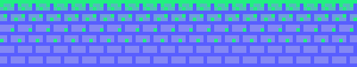
PLAYER 1
HIGHSCORE 2500
PLAYER 2
DC--
AVOID THE DISCIPLINARY COMMITTEE

Slide 2









01
07
12
OBJECTIVE
Throughout the game, you will face several levels, or arcs and will be given choices.
choose your decisions to avoid getting the dc action on you.
GOOD LUCk, have fun!!

Slide 3






01
07
12
LEVELS
TOPICS COVERED
HOME ARC
CLASSROOM ARC
SOCIETY ARC
Hall arc

Slide 4








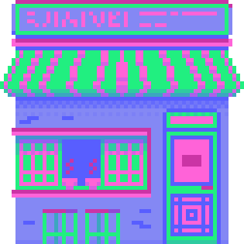


Back to levels Page
HOME ARC

Slide 5

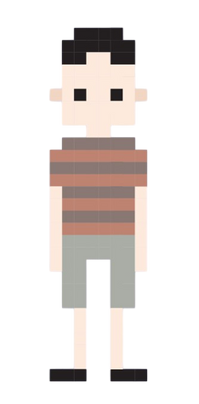
YOU:
Uhh, what time is it?

Slide 6

Get UP
A few more minutes wont hurt...
YOU:
Shit, I’m gonna be late for class, the prof is definitely going to dereg me this time, but I don’t want to get up!

Slide 7


You open your eyes and look at the time
You have an email from your professor:
Dear Player1,
You have been deregistered from the course, and your dear friend “Teach HersPetS Nake” from your class has informed me of all the nice things you have said about me. Hence, you can expect a mail from the DC today.
Regards
Professor Powa Trip

Slide 8


go to last checkpoint

Slide 9

Oh wait:
You don’t know how to open your eyes!
Worry not I will teach you.
Almost every graphical interface, like this one, once used(and may still be using) OpenGL to render the graphics.
But what is OpenGL ?

Slide 10
“The GL stands for Good Luck because you’re gonna need it”
1
2
3
OpenGL is mainly considered to be a graphics API widely used to render the graphics we see on the screen in many popular software.
However, OpenGL by itself is not an API but merely a specification developed and maintained by the Khronos Group.
The OpenGL specification specifies exactly what the result/output of each function should be and how it should perform.

Slide 11

Who Makes It?
The Spanish Inquisition, unexpected, right?
Well, frankly, anyone who needs it.
GPU manufacturers often tweak and create new libraries as extensions, in order for OpenGL functions to be compatible with the code
This also means that whenever OpenGL is showing weird behavior that it shouldn't, this is most likely the fault of the graphics cards manufacturers.

Slide 12

YOU use OpenGL to set the viewport and now finally you can see
In OpenGL, a viewport defines the rectangular area of the window where the final rendered image is displayed. It essentially maps normalized device coordinates (NDC), which range from [−1,1][-1,1][−1,1] in both x and y axes, to window coordinates (pixel coordinates).

Slide 13
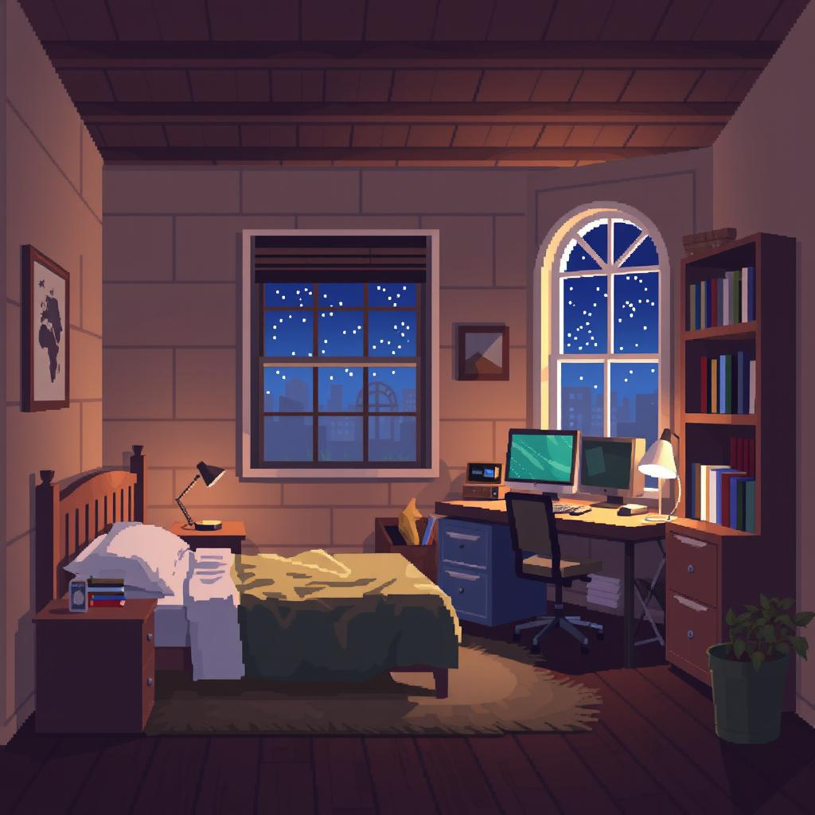
Run to class
neighbours room
YOU:
Finally I’m up, what do I do now?

Slide 14
You keep knocking at the door. After 20 minutes, his roomie opens the door, says that your batchie Teach HersPetS Nake already left. You call him for proxy, he does not pick up, but you get an email:
Dear Player1,
You have been deregistered from the course, and an anonymous student from your class has informed me of all the nice things you have said about me. Hence, you can expect a mail from the DC today.
Regards
Professor Powa Trip

Slide 15
go to last checkpoint

Slide 16
But... How do you move again?
Oh, right, we use linear transforms and matrix multiplication on the current coordinates to translate or rotate the view accordingly

Slide 17
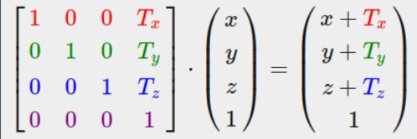
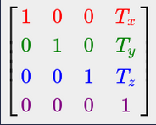
Transforms: Translation
This transform can be applied by algebraically adding to the matrices. This is represented as a matrix product as:
Hence, the transform matrix is obtained as :

Slide 18
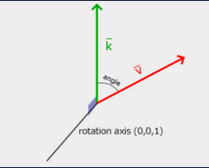
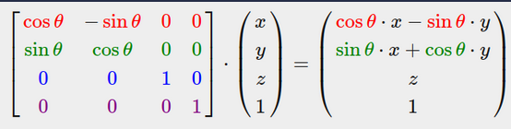
Transforms: Rotation
Using this axis system as reference:
We obtain, as a matrix product:

Slide 19
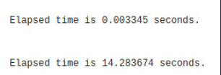
But Why Matrix Operations?
Are we all really a part of a simulation?
Well, that is because matrix multiplications and operations allow us to perform multiple operations at the same time using Parallel computing.
Since GPUs excel at parallel computing, they are well suited for these tasks.
For Example: This is the time taken by GPU vs CPU(single core) for a random 10000 * 10000 matrix multiplication
Time taken by GPU:
Time taken by CPU:

Slide 20
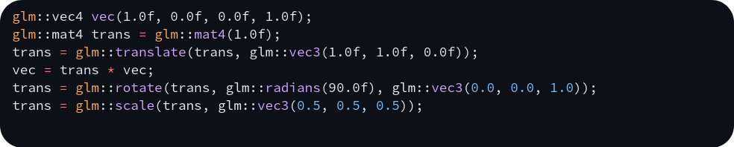
you multiply your current coordinates with the required coordinates and start running towards the school
In OpenGL, we use the glm library to create, manipulate and operate with vectors and matrices.

Slide 21
Back to LEVELS menu
01
06
01
CongratulatIons!
You have cleared The
HOME ARC!!

Slide 22
Back to levels Page
CLASSROOM ARC

Slide 23
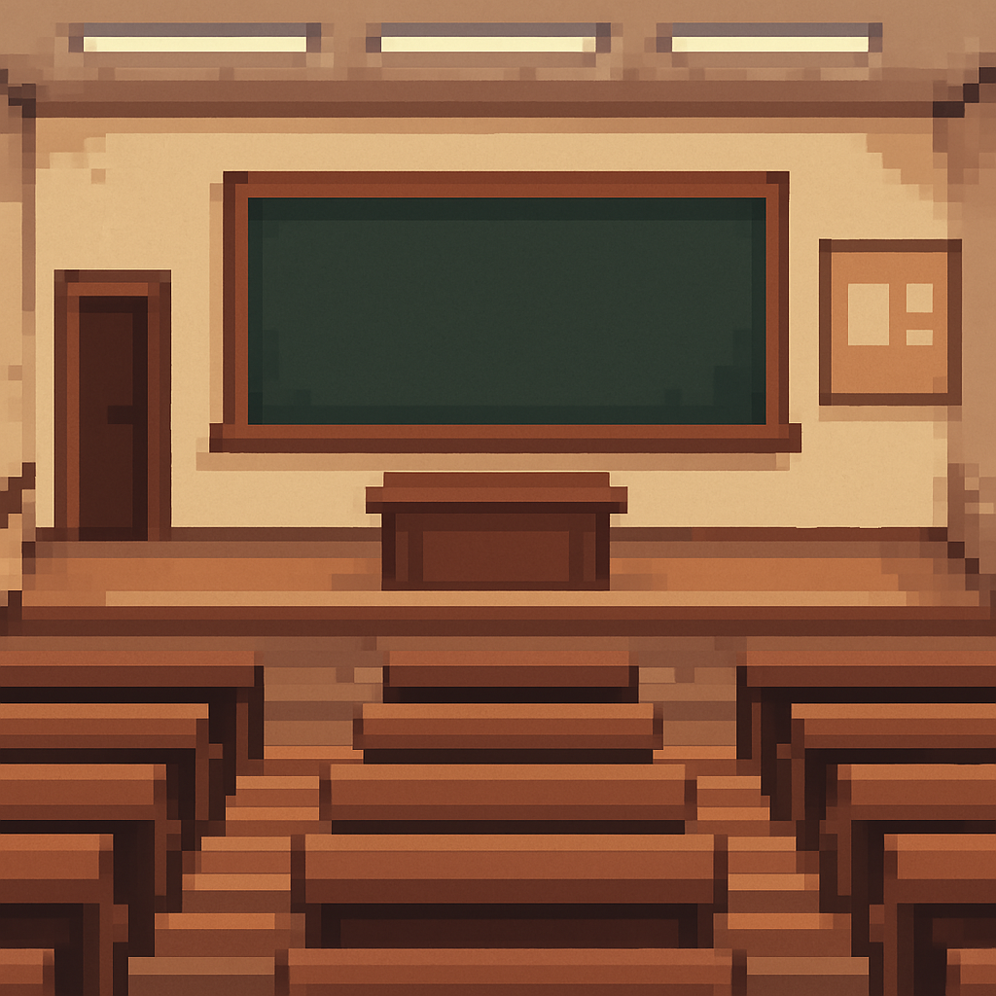

Talk to Friends
REview class material
YOU:
Barely got here before time, YES! The prof is not here yet, I still have time to kill

Slide 24
You start talking to Nake

Slide 25
YOU:
Hey man, what’s up?

Slide 26
NAKE:
There's not much, just talking about the sadistic professor and how he loves to torture us. I mean, who announces a test the very day its supposed to happen?

Slide 27
YOU:
What??? There’s a test today? Oh man, I’m cooked, there's no way I’m passing today, I just hate sadistic Trip, I feel like he has a personal grudge against me, I always paid attention when he used to teach, he's just so bad that I cannot anymore.

Slide 28
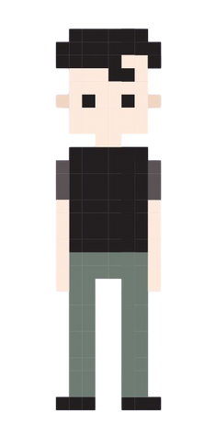
Powa:
Well, even if I didn’t before, I now have a grudge against you. For badmouthing a professor, you not only get a P in my class, but also, a mail from the DC.

Slide 29
YOU:
What? Why a P, just give me an F

Slide 30
Powa:
Because you can improve an F in the supplementary, but not a P.

Slide 31
go to last checkpoint

Slide 32
You go to read a book, But You forgOt!! you have no book!! What do you do?
Simple, if you forgot the book, just make one!! Using OpenGL
Any render in OpenGL follows the same basic steps, known as:
OpenGL Render Pipeline

Slide 33
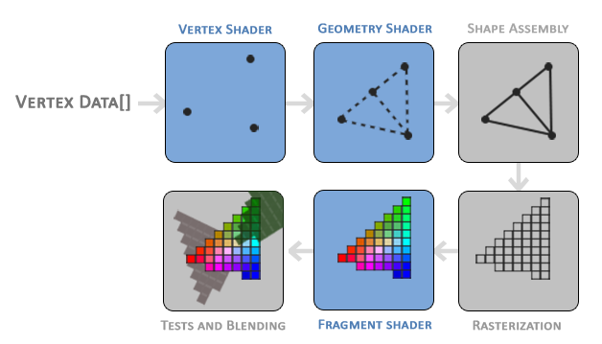
Render Pipeline
“I couldn’t think of a punchline here, so I punched a pipe”

Slide 34
Render Pipeline
Shape Assembly
Vertex Shader
In this step, the program takes as input all the vertices (or vertex if GL_POINTS is chosen) from the vertex (or geometry) shader that form one or more primitives and assembles all the point(s) in the primitive shape
The vertex shader is defined, written and linked to the program
This is an optional step that is used to apply some geometric transforms to the output of the vertex shaders
Geometry Shader

Slide 35
Render Pipeline
Rasterization
Tests and Blending
The output of the primitive assembly stage is then passed on to the rasterization stage where it maps the resulting primitive(s) to the corresponding pixels on the final screen, resulting in fragments for the fragment shader to use.
This stage checks the fragment's corresponding depth (and alpha) value and uses those to check if the resulting fragment is in front or behind other objects and should be discarded(or blended) accordingly.
This step calculates the color values of each pixel and maps the, to the associated pixel. Most OpenGL effects are applied in this step
Fragment Shader

Slide 36
you learnt about the render pipeline, now all that's left is to design and get the book
Note that some steps of the render pipeline are optional and may or may not be used.

Slide 37
borrow book
GO to the 3d printer
YOU:
Now I know how to make the book... WAIT, HOW DO I DO ALL THAT, what should I do?

Slide 38
You start going to the 3d printer

Slide 39
trip:
Where do you think you are going, Mr. Player1, the class has started, go sit down, too late to leave the class.

Slide 40
YOU:
No sir, I was just dropped my eraser... (Acts to pick something up and goes back)

Slide 41
Trip:
So class, I know there was supposed to be a test today, but it is cancelled because the printer has malfunctioned. No test today

Slide 42
YOU:
I must have been a very good person, god is protecting me.

Slide 43
NO, I am. It is just plot armor
Skip to after the class

Slide 44
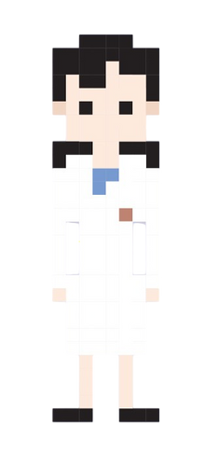
ITISMA Crush:
Hey Player1, what are you up to?

Slide 45
YOU:
Heyyyyyyy, n-nothing much mostly free whats up?

Slide 46
ITISMA Crush:
Listen, I am doing a 3D modelling project, today, but I have no idea how to do it in OpenGL, could you pleeeease help me with it?

Slide 47
YES! ANYTHING FOR YOU
SORRY I don’t know how to do that
YOU:
...

Slide 48
YOU:
I’m sorry, I do not know how to do that T_T

Slide 49
ITISMA Crush:
Oh, no problem.(Leaves)

Slide 50
YOU:
Is this how my love story ends?

Slide 51
Yes
You never talked again

Slide 52
go to last checkpoint

Slide 53
Yes
But i make the rules

Slide 54
YOU:
YEAH! Sure, anything for yo- I mean its cool, its cool.

Slide 55
AH to be young
But how are you gonna teach her when you don't even know what shaders are?

Slide 56
I guess i’ll have to teach you
About the S(H)adistic part of opengl

Slide 57
S(h)adistic OpenGL
“I know what I wrote”
Shaders are little programs that rest on the GPU.
These programs are run for each specific section of the graphics pipeline. In a basic sense, shaders are nothing more than programs transforming inputs to outputs.
Shaders are also very isolated programs in that they're not allowed to communicate with each other
The only communication they have is via their inputs and outputs.

Slide 58
Entonces, ¿qué lenguaje entienden los shaders?
“So what language do shaders understand?”
Shaders are written in a C-like syntax, and are generally stored in the form of .txt files, which are then fed to the program by using standard file input and output.
This syntax is called “GLSL”
GLSL is tailored for use with graphics and contains useful features specifically targeted at vector and matrix manipulation
It has libraries like “glm” that have pre-defined implementation of commonly used mathematical operations and objects.

Slide 59
GLSL Structure
“Get Shady and face the Aftermath”
Version and input variable declaration
Definition of Output Variables
Declaration of other Variables
Main Function and Output Variables
In this part, we define the version number to be used for the shader and the input variables that need to be passed to the shader.
Here, we tell OpenGL what out shader will output, as that will be passed as input to the next shader in the pipeline
In this part, we define Uniforms, which are used to send data from the CPU to the GPU. (The input variables send data across shaders). We can also define Helper Variables.
Here, we define what operations need to be performed before assigning values to the output variables inside a main() function.

Slide 60
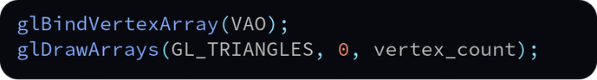
Accessing Shaders
Go Fetch! (the Shaders)
We read the shader file and extract the text. We store it as a C string as OpenGL supports that format. We then store all the shaders in a sequence as each shader is characterised by its address, an unsigned int
Creating a Window
Intermediates
This part varies from program to program. The most common implementation is usage of a Triangle Mesh which uses the following snippet to draw the triangle
We create a window using GLFW. This window is where all the graphics output shows up.
In this part, we delete the shader program we created and free the memory
Making The Shader
Clean Up

Slide 61
Four Shade(r)s of OpenGL
NSFW Warning(excessive crying)
Shaders are of (mainly) four types:
Vertex Shaders
Fragment Shaders
Geometry Shaders
Compute Shaders
Additionally, there are two more types of shaders:
Tessellation Control Shaders
Tessellation Evaluation Shaders

Slide 62
Vertex Shaders
“You need to be sharp to implement these”
The Vertex Shader is the programmable Shader stage in the rendering pipeline that handles the processing of individual vertices.
Vertex shaders are fed Vertex Attribute data, as specified from a vertex array object by a drawing command.
A vertex shader receives a single vertex from the vertex stream and generates a single vertex to the output vertex stream.
There must be a 1:1 mapping from input vertices to output vertices.
User-defined input values to vertex shaders are sometimes called "vertex attributes". Their values are provided by issuing a drawing command while an appropriate vertex array object is bound.
Output variables from the vertex shader are passed to the next section of the pipeline.

Slide 63
Fragment Shaders
A fragment shader is a stage in the OpenGL pipeline that processes fragments (potential pixels) generated during rasterization. It takes interpolated vertex data as input and outputs:
Depth value
Color values for the framebuffer
Stencil value (unmodified)
The shader operates per fragment, allowing for operations like texturing and lighting, and is crucial for rendering detailed graphics.

Slide 64
Geometry Shaders
A Geometry Shader (GS) is a Shader program written in GLSL that governs the processing of Primitives.
The main reasons to use a GS are:
Layered rendering: taking one primitive and rendering it to multiple images without changing bound render targets.
Transform Feedback: This is often employed for computational tasks on the GPU (obviously pre-Compute Shader).

Slide 65
Compute Shaders
A Compute Shader is a special type of shader in OpenGL designed for general-purpose parallel computing on the GPU.
Unlike other shaders (vertex, fragment, geometry), compute shaders do not operate within the graphics pipeline—instead, they are executed as standalone programs for tasks like physics simulations, image processing, and AI.

Slide 66
Now You know about OpenGL shaders. You can proceed with your teen romance
But since no romance is allowed in the classroom, let's move to your society

Slide 67
Back to LEVELS menu
02
12
02
CongratulatIons!
You have cleared The
classroom ARC!!

Slide 68
Back to levels Page
SOCIETY ARC

Slide 69
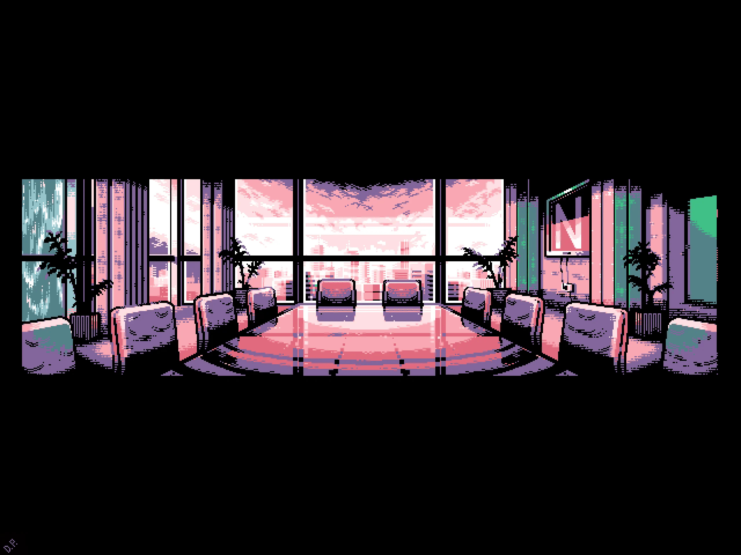
ITISMA Crush:
Hey Player1, are you ready?

Slide 70
YOU:
Yes, so in order to create the models, you need to first define the shaders-

Slide 71
ITISMA Crush:
No, I know that. I need help loading my pre-built .obj model into my window. After you make the model obviously.

Slide 72
Sure we can do that
SOrry, I don’t know how to do that
YOU:
I hate my life

Slide 73
YOU:
I’m sorry, I do not know how to do that T_T
Feels like deja vu

Slide 74
ITISMA Crush:
Oh, no problem. Guess then we can leave, could you please close up the meeting room behind me?

Slide 75
YOU:
Sure
Of course this happens

Slide 76
Itisma leaves
Professor trip enters

Slide 77
Trip:
Player1? What are you doing here, last I checked you did not have the keys to this room?

Slide 78
YOU:
Great. Just what I was missing.
No sir, I was here with someone else, they just left.

Slide 79
Trip:
Lying? You must be here to steal something, tell your excuses to the DC.

Slide 80
YOU:
Perfect

Slide 81
go to last checkpoint

Slide 82
SO I guess we need to learn this as well, you must treat me after this boy

Slide 83
Understanding objects
Objects are stored in the form of .obj files
These objects have five sections:
usemtl and mtllib describe the look of the model. We won’t use this in this tutorial.
v is a vertex
vt is the texture coordinate of one vertex
vn is the normal of one vertex
f is a face
v, vt and vn are followed by the coordinates required.
As for f, for a sample value of “f 8/11/7 7/12/7 6/10/7”,
The three values correspond to the three vertices of the triangle
8 = 8th coordinator
11 = 11th texture parameter

Slide 84
Reading the file
In simple words, we read the file line by line, separate content on each line and add it to the respective list to store them.
We then plot them like we usually plot points and add textures to them.
We add a condition for the first element from the split to separate the different values.
Then we pass the respective vectors to the plot function rather than our arrays.

Slide 85
YOU:
Here, we are done!

Slide 86


Slide 87
ITISMA Crush:
The model is done but there is one small problem. That looks NOTHING like me, are you trying to make fun of me?

Slide 88
YOU:
No, I didn’t mean that and you do look like this-

Slide 89
ITISMA Crush:
Alright then, ThAnK yOu FoR yOuR hElP (leaves)

Slide 90
YOU:
Sure, perfect.

Slide 91
Now You know about how to load obj models into opengl! have fun LOL
The obj models can be created using 3D modelling software like Blender. The main reason to use them is to avoid manually typing every single point every time we write a program.

Slide 92
Go to the bus stop
go to the parking lot
YOU:
Now that that's all over, let’s head home.

Slide 93
You go to the parking lot, and some kids are playing Cricket
You ask them and they let you play for one over, you hit it hard and its in the air

Slide 94
TRIP:
*Crash* Hey who was that? Who broke my side view mirror?

Slide 95
YOU:
Oh man

Slide 96
Trip:
So it was you Player1, damaging a Professor’s vehicle to get revenge, guess what I’ll get you?

Slide 97
YOU:
... A DC mail...

Slide 98
go to last checkpoint

Slide 99
YOu reach the bus stop

Slide 100
Random Student:
Man, our bus really is old, the colors are way off

Slide 101
YOU:
Oh, that’s just because our world still uses the primitive lighting method; we need to switch to the “Blinn-Phong Method” soon.

Slide 102
SO I guess I will have to teac-
wait what? he knows this?

Slide 103
Random Student:
What is that?

Slide 104
YOU:
Let me explain.

Slide 105
Primitive lighting
And then god said, “Let there be light”
Primitive Lighting is the method where the actual observed color of an object is defined by simply multiplying the values of the light source intensities and the actual color of the object.
This gives a good enough approximation of the light but is extremely color inaccuar

Slide 106
Advanced Lighting
And then god said, “Let there be light”
Normally, advanced lighting in OpenGL is done by combining:
Ambient Lighting
Diffuse Lighting
Specular Lighting
A combination of these lighting methods gives us a pretty accurate depiction of the lighting in real life.
This is called the ‘Phong’ lighting style.
The main drawback with this method is that its specular reflections break down in certain conditions, specifically when the shininess property is low resulting in a large (rough) specular area.

Slide 107
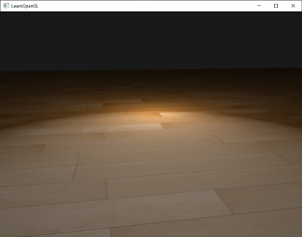
Advanced Lighting
And then god said, “Let there be light”
You can see at the edges that the specular area is immediately cut off. The reason this happens is because the angle between the view and reflection vector doesn't go over 90 degrees. If the angle is larger than 90 degrees, the resulting dot product becomes negative and this results in a specular exponent of 0.0
To overcome this problem, we introduce a halfway vector and use the “Blinn-Phong” lighting method

Slide 108
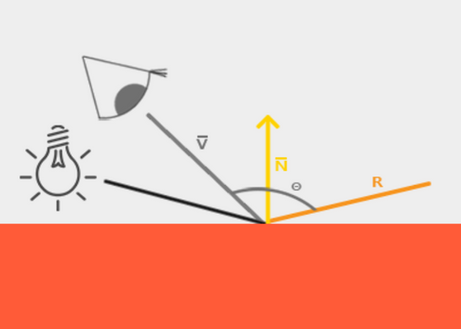
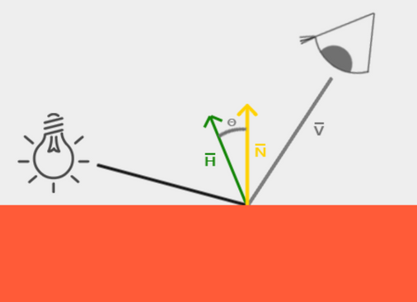
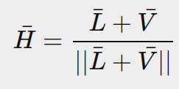
Blinn-Phong Lighting
In this method, instead of using the angle between the view vector and the normal vector as the Specular metric, we define a vector halfway between the view and the lighting vector and use the angle between the Halfway Vector and the Normal Vector as the Specular metric, ensuring that the angle never exceeds 90°.
Phong
Blinn-Phong
Where,

Slide 109
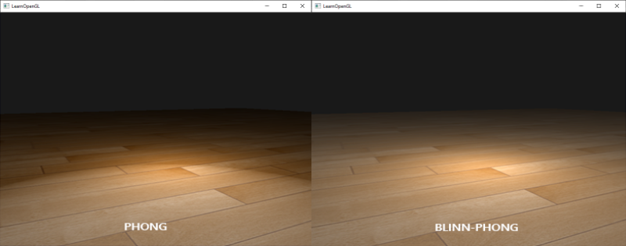
Blinn-Phong Lighting
An example on the previously used image:
Phong
Blinn-Phong

Slide 110
Random Student:
Oh that makes sense, so when are we switching?

Slide 111
YOU:
I don’t know

Slide 112
I don’t know if this counts as an achievement, but ok, now you know About advanced lighting in opengl...
These lighting methods prove to be extremely instrumental in various projects as lighting is the most important emphasis-inducing element.
You get off the bus and start walking.

Slide 113
Back to LEVELS menu
03
18
03
CongratulatIons!
You have cleared The
Society ARC!!

Slide 114
Back to levels Page
HALL ARC

Slide 115
Take the long path
Take a shortcut
YOU:
...

Slide 116
YOU:
Let’s walk for longer today

Slide 117
You reach your hall after your detour and see the warden standing there

Slide 118

WARDEN:
Mr, Player1 what time were you supposed to be back today?

Slide 119
YOU:
But sir it isn’t even 7:00 pm

Slide 120
WARDEN:
Didn’t you read the notice, you were supposed to be back by 4 today, since it was a half day and there is an event, where have you been, well either way, I don’t care, answer the Hall DC.

Slide 121
go to last checkpoint

Slide 122
YOU:
I don’t have time. Guess I’m taking the short path today.

Slide 123
You move forward and crash into a pole

Slide 124
YOU:
Man! why didn’t I see the pole?

Slide 125
That is due to the SDR lighting of this world

Slide 126
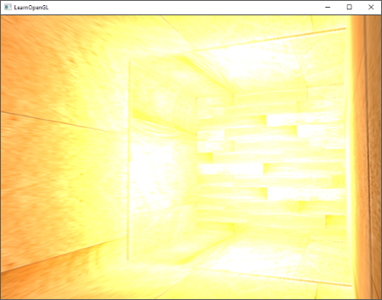
HDR Lighting
And then god said, “Let there be better light”
When many pixel brightness intensities reach a value of more than 1, they are all clipped to 1. As a result, all those pixels appear at the same intensity, destroying the image quality. Resulting in an image like this.
One proposed solution is scaling down all pixels, which results in a sunglasses-like look
By allowing fragment colors to exceed 1.0 we have a much higher range of color values available to work in known as high dynamic range (HDR).

Slide 127
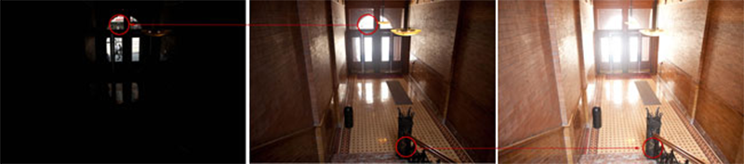
How it Works
“Let’s not oversaturate things”
High dynamic range was originally only used for photography where a photographer takes multiple pictures of the same scene with varying exposure levels, capturing a large range of color values. Combining these forms a HDR image where a large range of details are visible based on the combined exposure levels, or a specific exposure it is viewed with.
We allow for a much larger range of color values to render to, collecting a large range of dark and bright details of a scene, and at the end we transform all the HDR values back to the low dynamic range (LDR) of [0.0, 1.0].
We use tone-mapping algorithms like Reinhard tone mapping

Slide 128
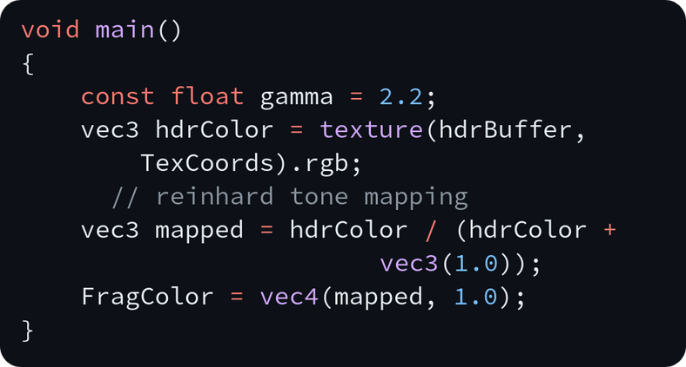
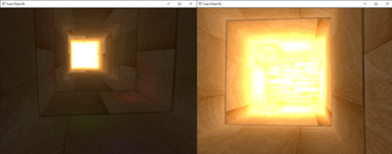
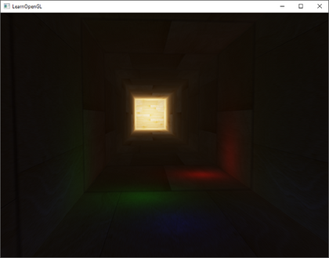
Reinhard tone mapping
“Let’s not oversaturate things”
Reinhard tone mapping involves dividing the entire HDR colour values into LDR colour values.
The Reinhard tone mapping algorithm evenly balances out all brightness values onto LDR.
Result:

Slide 129
Now you know about HDR lighting
This lighting method is widely used in the gaming and video industry, as videos with HDR are often much better perceived than non-HDR ones.
You enter your room and lie down.

Slide 130
YOU:
Finally, Inner peace. Oh god I am tired. Why am I tired on such a relaxing day.

Slide 131
That is because there is no concept of vertex post-processing

Slide 132
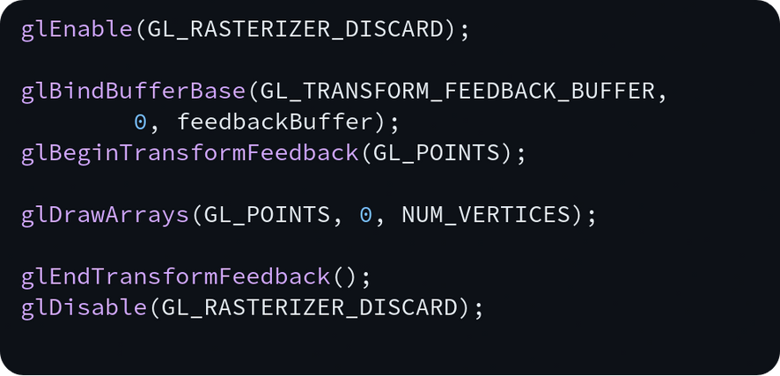
Transform Feedback
Ben 10 Nostalgia
Transform Feedback is an OpenGL feature that captures the output of the vertex shader (or geometry shader) and writes it directly into a buffer without passing through the fragment stage.
This allows us to store transformed vertices for later use, without sending them to the screen
The process involves:
Enable transform feedback mode
Bind a buffer to store the output
Define which variables to capture
Render geometry (without rasterization)
Retrieve transformed data

Slide 133
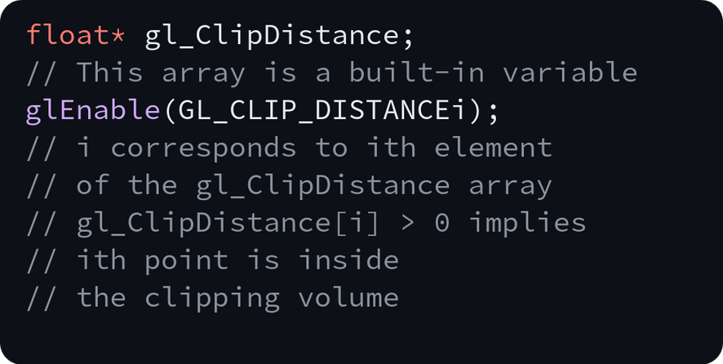
Clipping
That reminds me, Clippy just got clipped out of existence, didn't he?
Primitives generated by previous stages are collected and then clipped to the view volume. Each vertex has a clip-space position (the gl_Position output of the last Vertex Processing stage).
While the clipping is automatically enabled by OpenGL, we can add an additional manual clipping factor by using:

Slide 134
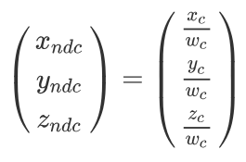
Perespective Division
Its a cultural divide, Imma get it on the floor
The clip-space positions returned from the clipping stage are transformed into normalized device coordinates (NDC) via this equation:

Slide 135
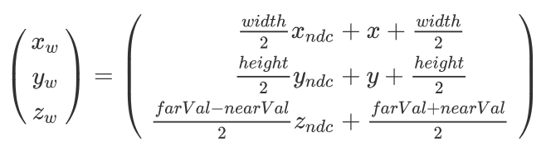
Viewport Transform
Converts NDC (-1 to 1 range) into window coordinates (pixel space).
Ensures that objects are mapped correctly onto the frame buffer.

Slide 136
Back to LEVELS menu
04
24
04
CongratulatIons!
You have cleared The
Hall ARC!!

Slide 137
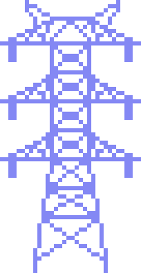

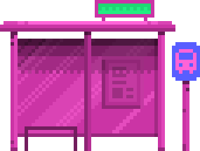


THANK YOU!
Anshumaan Mishra
24CS10082

